Slide 1




Slide 2

DATA ARRANGEMENT
(MULTI-DIMENSIONAL ARRANGEMENT)

Slide 3
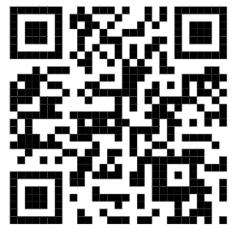
Test time on : DATA ARRANGEMENT
QR CODE:

Slide 4
DIRECTION-1 TO 5 QUESTION
Direction: Study the following information carefully to answer these questions.
A, B, C, D, E, F and G are members of a sports club and have liking for different games, viz Carrom, Table Tennis, Badminton, Bridge, Hockey, Football and Lawn Tennis but not necessarily in the same order. Each one of them has a liking for different musical instruments, viz Sitar, Guitar, Harmonium, Flute, Tabla, Banjo and Santoor, not necessarily in the same order. B likes Carrom and Banjo. E likes to play Bridge but not Harmonium or Tabla. The one who plays Hockey plays Sitar. F plays Guitar but not Table Tennis or Lawn Tennis. A plays badminton and Flute. The one who plays Lawn Tennis does not play Tabla. C plays Harmonium and G plays Hockey.

Slide 5
Question: 01
D plays which game ?
Table Tennis
Lawn Tennis
Football
None of these
Answer : A

Slide 6
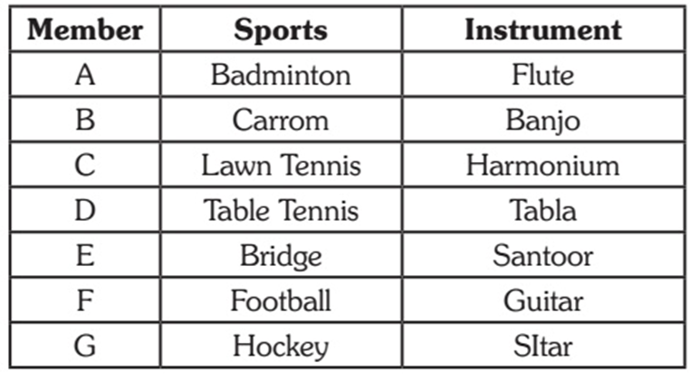
Explanation:

Slide 7
Question: 02
Who plays Santoor ?
D
A
E
D OR E
Answer : C

Slide 8
Explanation:

Slide 9
Question: 03
Which of the following combinations of gameperson-musical instrument is definitely correct?
Badminton-B-Flute
Table Tennis-E-Santoor
Lawn Tennis-D-Tabla
None of these
Answer : D

Slide 10
Explanation:

Slide 11
Question: 04
Who plays Football?
C
D
G
F
Answer : D

Slide 12
Explanation:

Slide 13
Question: 05
Who plays Table Tennis?
C
F
D
D. A
Answer : C

Slide 14
Explanation:

Slide 15
DIRECTION-6 TO 8 QUESTION
Direction: Study the following information carefully and answer these questions.
P, Q, R, S, T, W and Z are seven students studying in three different institutes – A, B and C. There are three girls among the seven students who study in each of the three institutes. Two of the seven students study BCA, two study medicine and one each studies Aviation Technology, Journalism and MBA. R studies in the same college as P, who studies MBA in college B. No girl studies Journalism or MBA. T studies BCA in college A and his brother W studies Aviation Technology in college C. S studies Journalism in the same college as Q. Neither R nor Z studies BCA. The girl who studies BCA does not study in college C.

Slide 16
Question: 06
In which college does Q study ?
A
C
B
D
Answer : A

Slide 17
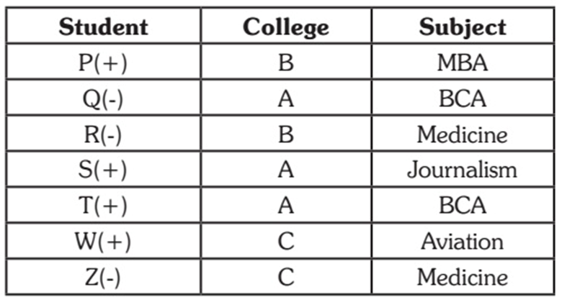
Explanation:

Slide 18
Question: 07
What is the field of study of Z ?
Aviation Technology
BCA
MBA
Medicine
Answer : D

Slide 19
Explanation:

Slide 20
Question: 07
Which of the following three represents girls ?
SQR
QRZ
SQZ
None of these
Answer : B

Slide 21
Explanation:

Slide 22
DIRECTION-9 TO 12 QUESTION
Direction: Study the following information carefully and answer the questions given below.
P, Q, R, S, T and M are six students of a school, one each studies in Class I – VI. Each of them has a favorite color from red, black, blue, yellow, pink and green, not necessarily in the same order. Q likes black and does not study in Class IV or V. the one who studies in Class IV does not like green. P studies in Class II. M likes blue and does not study in Class IV. The one who likes yellow studies in Class VI. S likes pink and studies in Class I. R does not study in Class VI.

Slide 23
Question: 09
In which class does R study?
V
III
IV
Data Inadequate
Answer : C

Slide 24
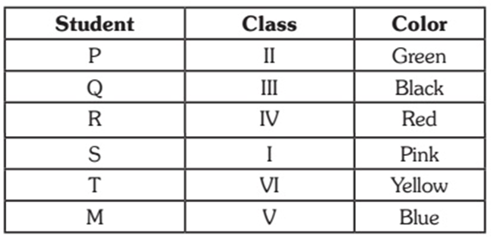
Explanation:

Slide 25
Question: 10
Which color does R like?
Black
Yellow
Green
None of these
Answer : D

Slide 26
Explanation:

Slide 27
Question: 11
Which color does P like?
Green
Yellow
Red
None of these
Answer : A

Slide 28
Explanation:

Slide 29
Question: 12
Which of the following combinations is correct ?
P – II – Yellow
Q – III – Green
S – I – Black
Data inadequate.
Answer : D

Slide 30
Explanation:

Slide 31
DIRECTION-13 TO 14 QUESTION
Four houses Blue, Green, Red and Yellow are located in a row in the given order. Each of the houses is occupied by a person earning a fixed amount of a salary. The four persons are Paul, Krishna, Laxman, and Som. Read the following instruction carefully:
I. Paul lives between Som and Krishna
II. Laxman does not stay in Blue house
III. The person living in Red house earns more than that of person living

Slide 32
DIRECTION-13 TO 14 QUESTION
IV. Salary of Som is more than that of Paul but lesser than that of Krishna
V. One of the person earns ₹ 80, 000
VI. The person earning ₹ 110,000 is not Laxman
VII. The salary difference between Laxman and Son is ₹ 30,000
VIII. The House in which Krishna lives is located between houses with persons earning salaries of 30,000 and ₹ 50,000
IX. Krishna does not live in Yellow house, and the person living in yellow house is not earning lowest salary among the four persons.

Slide 33
Question: 13
Who lives in Red house?
Paul
Krishna
Laxman
Son
Answer : B

Slide 34
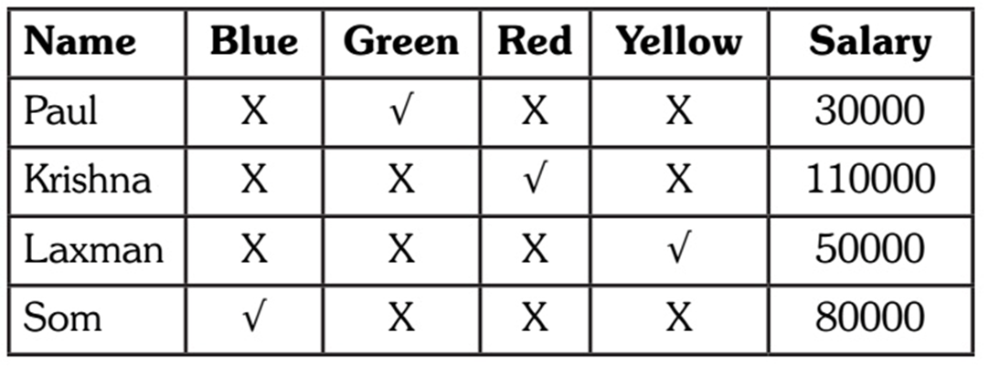
Explanation:

Slide 35
Question: 14
Which house is occupied by person earning highest salary ?
Blue
Green
Red
Yellow
Answer : C

Slide 36
Explanation:

Slide 37

https://learn.codemithra.com

Slide 38




THANK YOU
+91 78150 95095
codemithra@ethnus.com
www.codemithra.com

